Slide 1
Queues
Presentation for use with the textbook Data Structures and Algorithms in Java, 6th edition, by M. T. Goodrich, R. Tamassia, and M. H. Goldwasser, Wiley, 2014

Slide 2
The Queue Abstract Data Type
6.2.1

Slide 3
The Queue ADT
The Queue ADT stores arbitrary objects
Insertions and deletions follow the first-in first-out scheme
Insertions are at the rear of the queue and removals are at the front of the queue
Main queue operations:
add(object): inserts an element at the end of the queue
object remove(): removes and returns the element at the front of the queue

Slide 4
The Queue ADT
Other queue operations:
object first(): returns the element at the front without removing it
integer size(): returns the number of elements stored
boolean isEmpty(): indicates whether no elements are stored
Boundary cases:
Attempting the execution of dequeue or first on an empty queue returns null

Slide 5
Queue Interface
public interface Queue<E> {
/**
* Returns the number of elements in the queue.
* @return number of elements in the queue
*/
int size();
/**
* Tests whether the queue is empty.
* @return true if the queue is empty, false otherwise
*/
boolean isEmpty();

Slide 6
Queue Interface
/**
* Inserts an element at the rear of the queue.
* @param e the element to be inserted
*/
void enqueue(E e);
/**
* Returns, but does not remove, the first element of the queue.
* @return the first element of the queue (or null if empty)
*/
E first();

Slide 7
Queue Interface
/**
* Removes and returns the first element of the queue.
* @return element removed (or null if empty)
*/
E dequeue();
}

Slide 8
Example
Operation Output Q
enqueue(5) – (5)
enqueue(3) – (5, 3)
dequeue() 5 (3)
enqueue(7) – (3, 7)
dequeue() 3 (7)
first() 7 (7)
dequeue() 7 ()
dequeue() null ()
isEmpty() true ()
enqueue(9) – (9)
enqueue(7) – (9, 7)
size() 2 (9, 7)
enqueue(3) – (9, 7, 3)
enqueue(5) – (9, 7, 3, 5)
dequeue() 9 (7, 3, 5)

Slide 9
Applications of Queues
Direct applications
Waiting lists
Access to shared resources (e.g., printer)
Routed phone calls to customer service

Slide 10
Array-Based Queue Implementation
6.2.2

Slide 11
Array-based Queue
Use an array of size N in a circular fashion
Two variables keep track of the front and size
f index of the front element
sz number of stored elements
normal configuration
Q
0
1
2
f
r

Slide 12
Array-based Queue
When the queue has fewer than N elements, array location r = (f + sz) mod N is the first empty slot past the rear of the queue
normal configuration
Q
0
1
2
f
r
First empty slot

Slide 13
Array-based Queue
normal configuration
Q
0
1
2
f
r
After a number of queue and dequeue operations, the value of r = (f + sz) mod N wraps around to a lower position in the array:
wrapped-around configuration
Q
0
1
2
r
f
First empty slot

Slide 14
Queue Operations
We use the modulo operator (remainder of division)
Algorithm size()
return sz
Algorithm isEmpty()
return (sz == 0)
Q
0
1
2
f
r
Q
0
1
2
r
f

Slide 15
Queue Operations (cont.)
Operation enqueue throws an exception if the array is full
This exception is implementation-dependent
Algorithm add(o)
if size() = N − 1 then
throw IllegalStateException
else
r ← (f + sz) mod N
Q[r] ← o
sz ← (sz + 1)
Q
0
1
2
f
r
Q
0
1
2
r
f

Slide 16
Queue Operations (cont.)
Note that operation dequeue returns null if the queue is empty
Algorithm remove()
if isEmpty() then
return null
else
o ← Q[f]
f ← (f + 1) mod N
sz ← (sz − 1)
return o
Q
0
1
2
f
r
Q
0
1
2
r
f

Slide 17
Queue Interface in Java
Java interface corresponding to our Queue ADT
Assumes that first() and remove() return null if queue is empty
public interface Queue<E> {
int size();
boolean isEmpty();
E first();
void add(E e);
E remove(); }

Slide 18
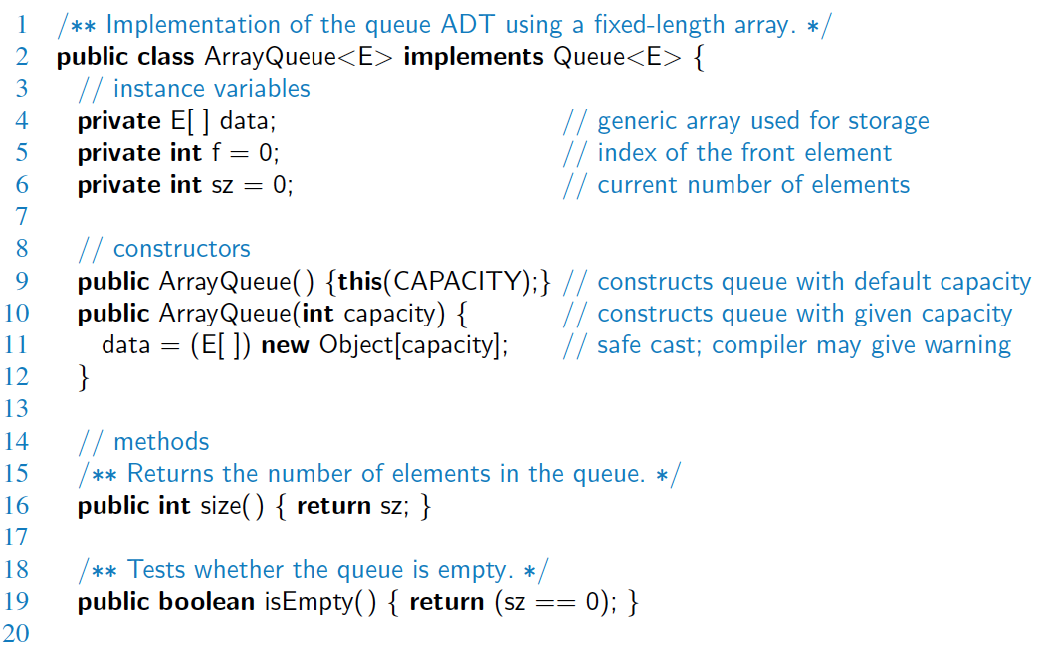
Array-based Implementation

Slide 19
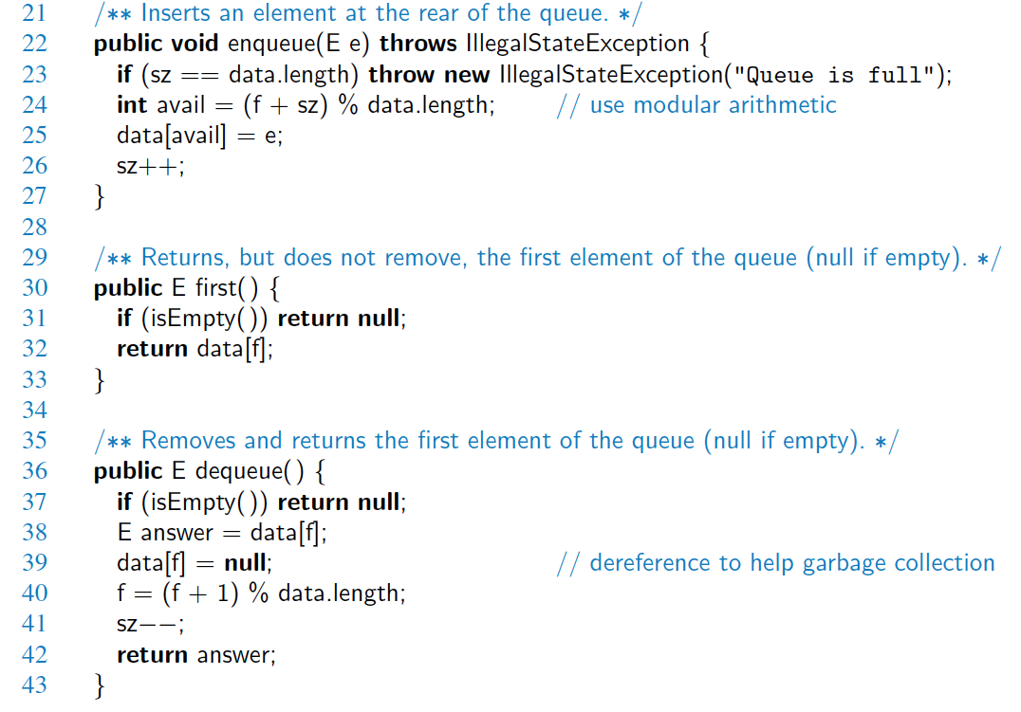
Array-based Implementation (2)

Slide 20
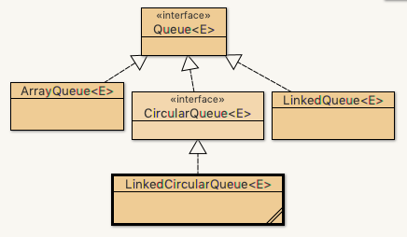
Array-Based Queue Example
Open with BlueJ
file ArrayQueue.java

Slide 21
Implementing a Queue with a Singly Linked List
6.2.3

Slide 22
Queue from a Singly Linked List
We can also implement a Queue based on a singly-linked list
All operations are O(1)
No limits on the capacity
Creating new nodes, manipulating the pointers make it more expensive per operation than array-based

Slide 23
Linked List Queue Example
Open with BlueJ
open
file LinkedQueue.java

